Slide 1

Will airways virtual Developer and Software Engineer and updates Conference
This presentation by William jones chief Developer And project MANAGER

Slide 2
what is the wAv Desktop App
VIRTUAL AIRLINE
It is Free
It open all AGE
It works with of FSX, FSX: Steam Edition, Prepar3D (any version

Slide 3
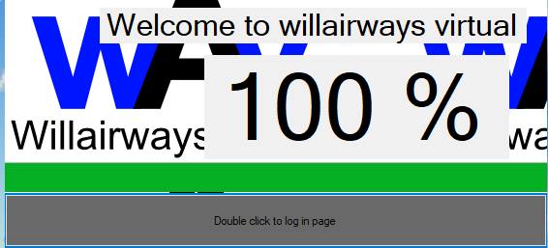

Slide 4
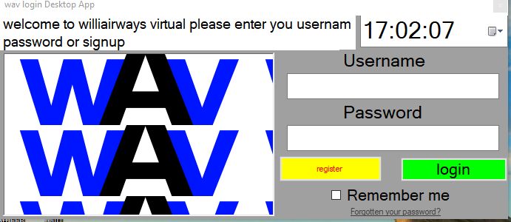

Slide 5
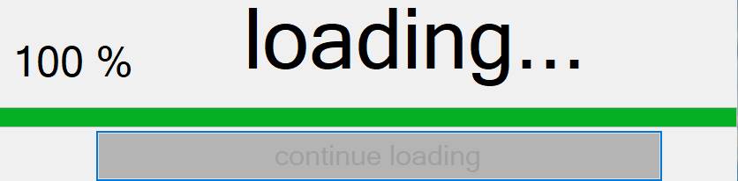

Slide 6
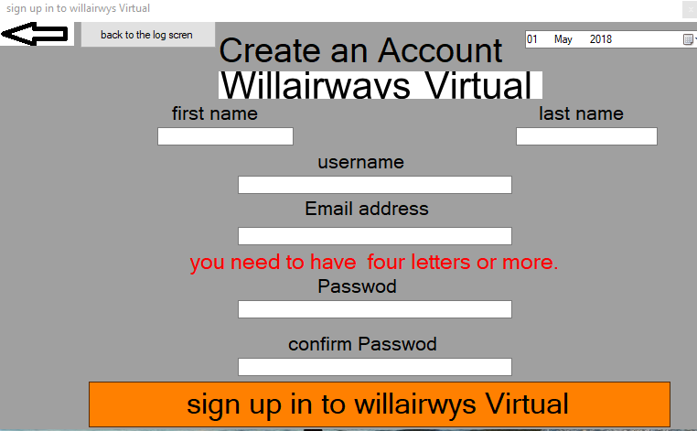

Slide 10
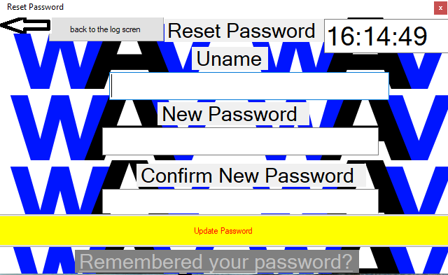

Slide 12
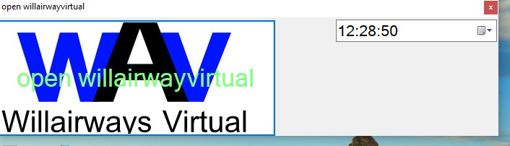

Slide 13
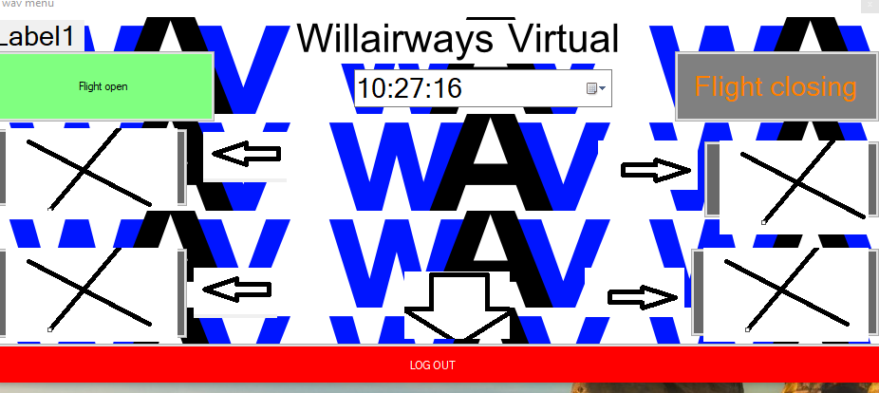

Slide 14
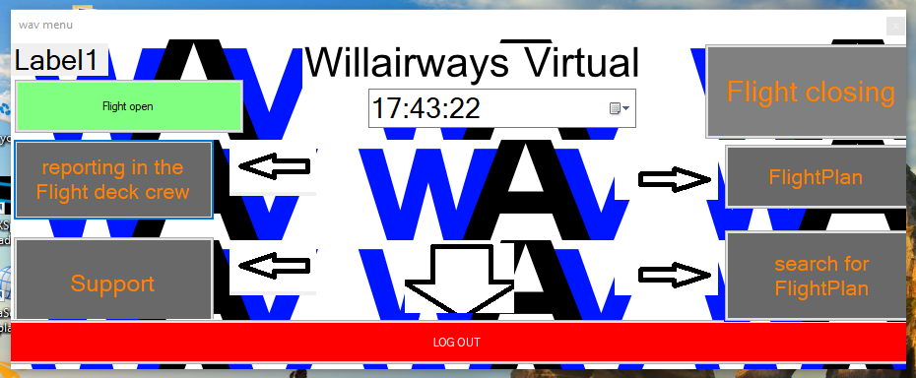

Slide 16
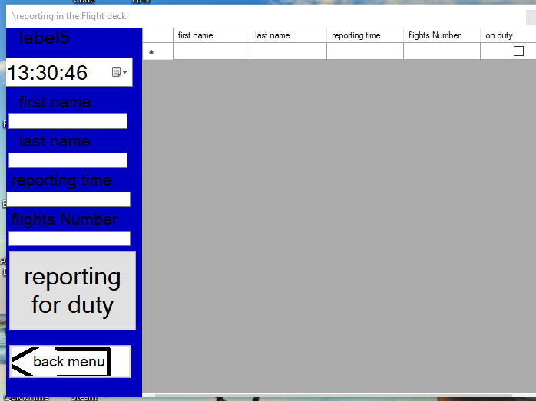

Slide 19
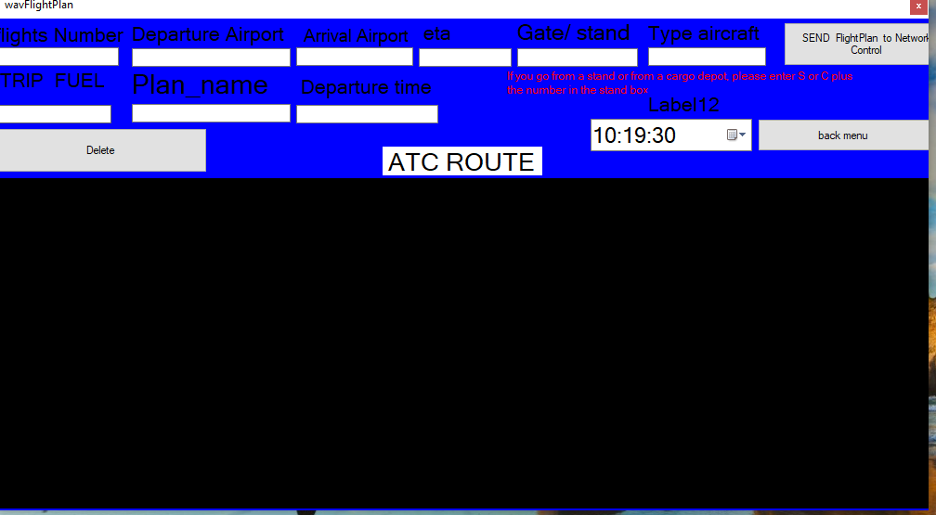

Slide 22
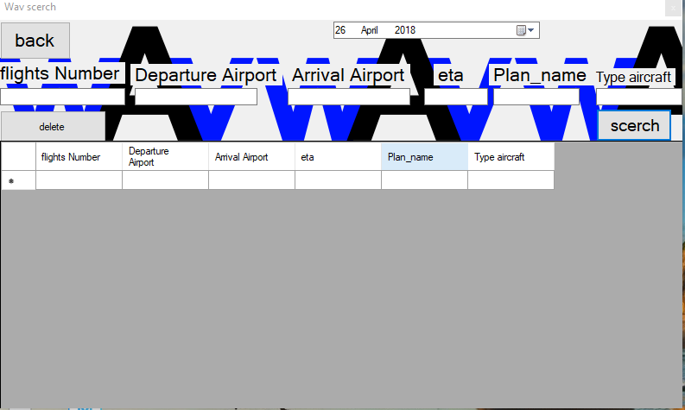

Slide 25
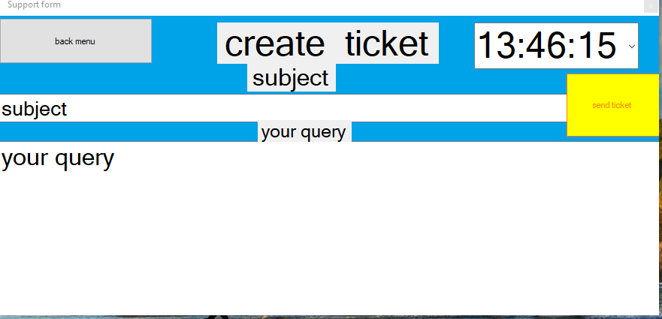

Slide 27
Status of you Account
We have 5 Account
Red Account
Silver Account
Gold Account
First Off Account
Capt. Account
How LONG you be here what Account or in open beta

Slide 28
Things to do and competed
Log in
Create an Account connect database
wav Desktop App2 open connect Log in
Flight Plan connect database
screech connect database
Desktop logo
reporting in the Flight deck crew database
Make Support form
Make a installer and setup
Get GitHub Account

Slide 29
Timeline for wav
P0 this june
P1and p0 is next month
P2 earlier July
P3 earlier of August
Beta earlier September
Releases 5 october2018

